Slide 1
Introduction to Angular 2
Day 03

Slide 2
Day 3 Agenda
Routing
Lifecycle Hooks
Debugging
Unit Testing Angular applications
NgModules

Slide 3
Routing

Slide 4
Routing
Why do we need Routing
It is important because we can
separate different areas of the app
maintain the state in the app
protect areas of the app based on certain rules
Routing let us to change the url for different pages within the application. Hence
You can maintain the page even after refresh
Bookmark a page
Share the url with others
Notes:
Give example of an Inventory application and talk about the necessity of book marking

Slide 5
Single Page applications (SPA)
SPA doesn't refresh the entire page to display different views
1
SPA is a collection of view states. Home, Product Details, Shipping etc
2
A component router allows the user to navigate from one view to another within the SPA
3
Notes:
Tip: Add your own speaker notes here.

Slide 6
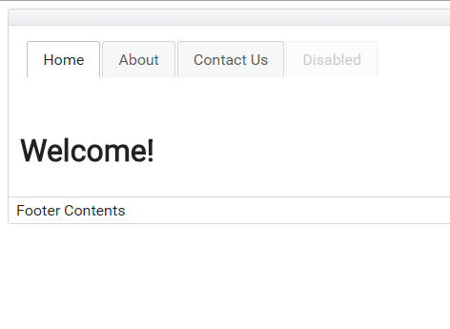
SPA
Different views will be displayed here.
<router-outlet></router-outlet>
These contents will not change
Notes:
Tip: Add your own speaker notes here.

Slide 7
Routing – location strategy
HashLocationStrategy – a hash sign (#) is added to the URL. The fragment after # identifies the route on the client
PathLocationStrategy - a History API based strategy works only in the browsers that support HTML5

Slide 8
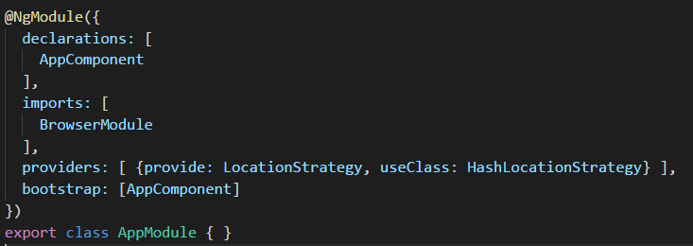
Routing – location strategy
HashLocationStrategy
http://mysite.com:8080/#/products/page/3
– Location on the server
– route path
– route parameter

Slide 9
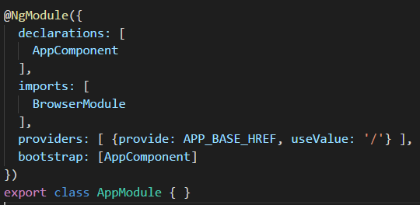
Routing – path location strategy
History API
http://mysite.com:8080/products/page/3

Slide 10
Routing
HTML5 side client side routing.
browsers acquired the ability to programmatically create new browser history entries that change the displayed URL without the need for a new request.
Achieved using history.pushState
In Angular4 HTML5 is the default mode
Not all browsers support HTML5 mode routing, so if you need to support older browsers you might be stuck with hash-based routing for a while.
The server has to support HTML5 based routing.

Slide 11
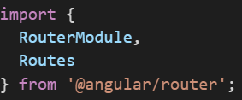

Components of Angular Routing
Components of Angular Routing
Routes describes the routes our application supports
RouterOutlet is a “placeholder” component that shows Angular where to put the content of
each route
RouterLink directive is used to link to routes
Imports
index.html

Slide 12
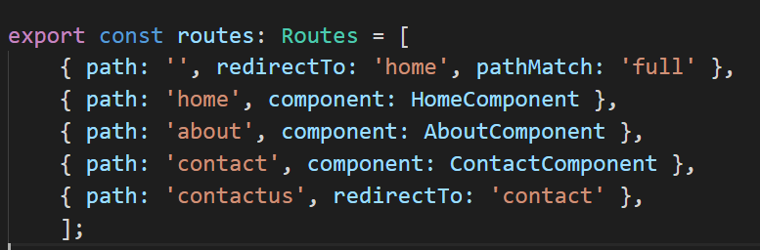
Components of Angular 2 Routing
Routes
Create routes configuration
path specifies the URL this route will handle
the optional redirectTo is used to redirect a given path to an existing route
pathMatch is needed for the default path(i.e) http:/localhost:4200
component is what ties a given route path to a component that will handle the route
Notes:
Default for other routes

Slide 13
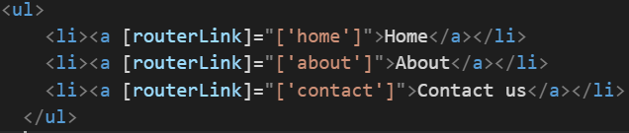
Components of Angular 2 Routing
Install the routes using RouterModule.forRoot(routes) in the imports of NgModule
RouterOutlet using <router-outlet>
Used to render the contents for each route
RouterLink using [routerLink]
Navigation using template links

Slide 14
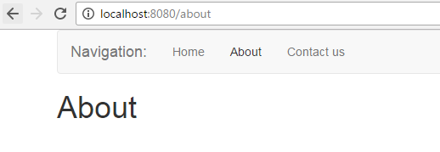
Build an Application

Slide 15


Route Parameters
If we have navigate to a specific resource, we use a route parameter
/route/:param
Import the ActivatedRoute

Slide 16
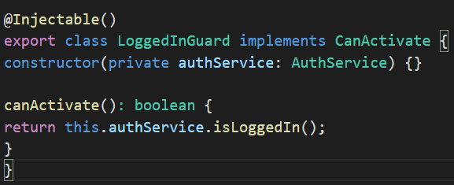
Protected Route
Guard class should implement CanActivate Interface
Protected component is activate only if canActivate function returns true.

Slide 17
Login Component to see the protected tab
Demo

Slide 18
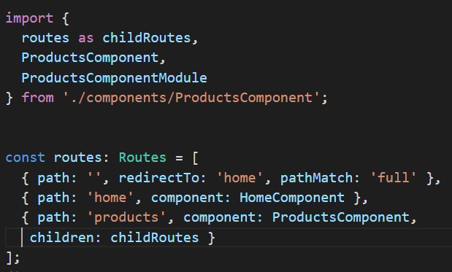
Nested Routes
Nested routes is the concept of containing routes within other routes. With nested routes we can encapsulate the functionality of parent routes and have that functionality apply to the child routes.

Slide 19
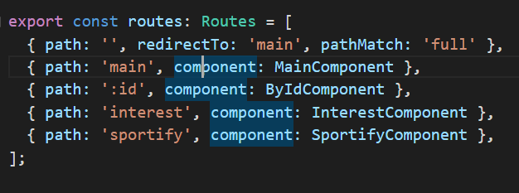
Nested Routes
ProductsComponent
When we visit /product directs to the main route
Fallback when none of the routes match. Everything that is passed after / will be extracted to the parameter of the route called id

Slide 20
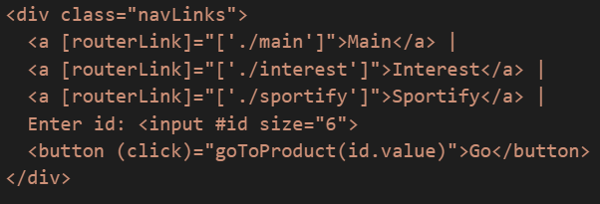

Nested Routes
We can navigate to Route without using [routerLink] using navigate method and providing the route name and an object with route parameters.

Slide 21
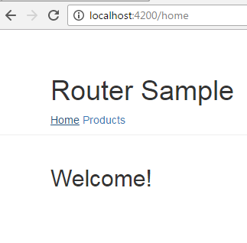
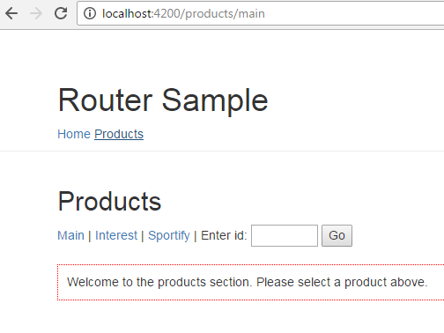
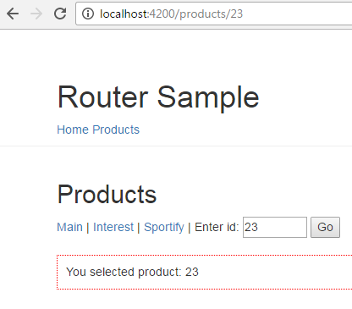
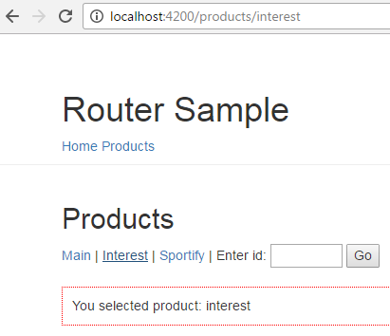
Nested Routes
Demo

Slide 22
Lifecycle Hooks

Slide 23
Lifecycle Hooks
Lifecycle hooks are the way Angular allows you to add code that runs before or after each step of
the directive or component lifecycle.
The list of hooks Angular offers are:
OnInit
OnDestroy
DoCheck
OnChanges
AfterContentInit
AfterContentChecked
AfterViewInit
AfterViewChecked

Slide 24
Lifecycle Hooks
In order to be notified
declare that your directive or component class implements the interface and then
declare the ng method of the hook (e.g. ngOnInit)

Slide 25

Lifecycle Hooks
OnInit and OnDestroy
OnInit hook is called when your directive properties have been initialized, and before any of the child directive properties are initialized.
OnDestroy hook is called when the directive instance is destroyed. This is typically used if we need to do some cleanup every time our directive is destroyed.
https://plnkr.co/edit/2ZhTRZ?p=preview

Slide 26
Debugging

Slide 27

Debugging
Augury
Debugging components from the Developer Console.
Demo

Slide 28
Unit testing Angular applications

Slide 29
Angular Testing Tools
Technology | Purpose
Jasmine | The Jasmine test framework provides everything needed to write basic tests
Angular testing utilities | Angular testing utilities create a test environment for the Angular application code under test. Use them to condition and control parts of the application as they interact within the Angular environment.
Karma | The karma test runner is ideal for writing and running unit tests while developing the application. It can be an integral part of the project's development and continuous integration processes.
Protractor | Use protractor to write and run end-to-end (e2e) tests. End-to-end tests explore the application as users experience it. In e2e testing, one process runs the real application and a second process runs protractor tests that simulate user behavior and assert that the application respond in the browser as expected.

Slide 30
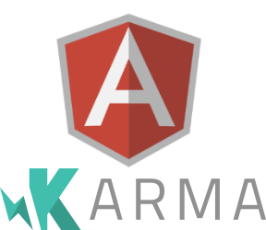
Karma
Karma is test running framework
It can run for any JavaScript testing framework (given that an adapter is created for that testing framework)
Karma spawns an instance of the browser(s) specified
Karma can watch for file changes, and run tests whenever those files change.
All Karma configuration is placed in the file karma.conf.js
Notes:
Karma is a test-runner created by the Angular team.
Naturally it is a very good fit for testing Angular applications.
Karma is essentially a tool which spawns a web server that executes source code against test code for each of the browsers connected.
The results for each test against each browser are examined and displayed via the command line to the developer such that they can see which browsers and tests passed or failed.

Slide 31

Jasmine
Behavior-Driven Open Source Unit Testing Framework
Works well with Angular’s injector.
Based on “describe” and “it” to make complete sentences based on expectation of functionality.
Strong readability
Helps logging errors
Includes matchers and possible customer matchers
toBe, not.toBe, toEqual, toBeTruthy, toMatch, etc.
Capable of running only one test suite or test case by using fdescribe and fit.

Slide 32
Jasmine
Jasmine is an open source testing framework that uses the BDD approach.
Suites : describe(string, function) functions, A test suite that takes a title and a function containing one or more specs.
Specs : it(string, function) functions, take a title and a function containing one or more expectations.
Notes:
Expectations are built with the function expect which takes a value, called the actual. It is chained with a Matcher function, which takes the expected value.

Slide 33
Jasmine
Jasmine is an open source testing framework that uses the BDD approach.
Expectations: assertions that evaluate to true or false. Basic syntax reads expect(actual).toBe(expected)
Matchers : are predefined helpers for common assertions called in expect methods. Eg: toBe(expected), toEqual(expected).
beforeEach() : Common setup code is defined here.
Notes:
Expectations are built with the function expect which takes a value, called the actual. It is chained with a Matcher function, which takes the expected value.

Slide 34
Angular Testing
@angular/core/testing provides wrappers and routines that Angular requires when testing components.
Each unit test is put into its own separate file.
Notes:
The Angular team recommends putting unit test scripts alongside the files they are testing and using a .spec filename extension to mark it as a testing script (this is a Jasmine convention). So if you had a component /app/components/mycomponent.ts, then your unit test for this component would be in /app/components/mycomponent.spec.ts.

Slide 35
Isolated unit tests vs. Integrated Test
Isolated unit tests
Examines an instance of a class only without any dependence on Angular or any injected values.
The tester creates a test instance of the class with new, supplies test doubles for the constructor parameters as required and probes the test instance API.
Eg: Test cases for Pipes and Services
Integrated Test
Tests both the class and its template.
Constructed using angular Angular Test Utilities
The Angular testing utilities include the TestBed class and several helper functions from @angular/core/testing
Eg: Test cases for Components and Directives
Notes:
You can test components in isolation as well. However, isolated unit tests don't reveal how components interact with Angular. In particular, they can't reveal how a component class interacts with its own template or with other components.
An isolated test of the controller will not involve testing of the template. They are appropriate for components and directives if you focusing on only the code and not the interaction with the template

Slide 36
Isolated unit Test
describe('AppComponent', () => { beforeEach(function() { this.app = new AppComponent(); }); it('should have hello property', function() { expect(this.app.title).toBe('app works!'); }); });

Slide 37
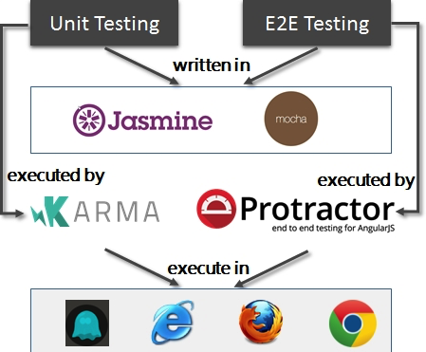
What is Protractor?
Functional testing framework that run tests cases against the application running in a browser.
Builds on top of:
Jasmine to specify the test cases
Selenium to talk through the browser
Protractor can also:
Run multiple browsers at once.
Run the tests on a remote address.

Slide 38
Angular Unit testing Framework
Angular provides its own set of classes that build upon the Jasmine framework to help writing unit testing for the framework.
The main testing framework can be found on the @angular/core/testing package
Mocks will be a more complete representation of objects, that overrides parts or all of the behavior of the dependency
Stubs are objects we create on the fly, with a subset of the behaviors our dependency has
Notes:
Example for stubs if the software requires data from database, instead of fetching the data from the database we create stubs.
Example for Mock – mock a http service to test the functionality. The behavior of a complex object such as a network socket can be mimicked by a mock object,

Slide 39
Testing with Angular Cli app
ng test runs the tests written and run the karma plugin.
ng test –code-coverage places the coverage reports under coverage folder

Slide 40
Testing Service class with Http
Interacting with a live service every time a test is run is a poor idea and hence angular provides with a way to create fake HTTP calls with MockBackend
This acts as a fake http library and for the code it acts as a real.
It provides the methods available in the real http.
MockBackend will actually allow us to setup expectations and watch for behaviors we expect.
Notes:
with a way to create fake HTTP calls with MockBackend

Slide 41
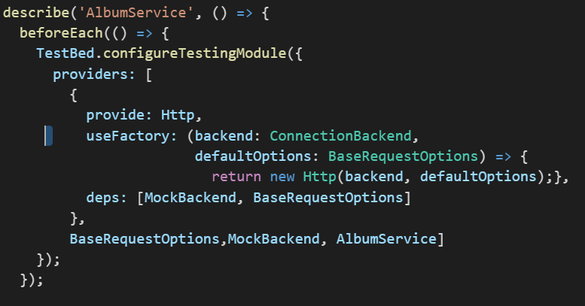
Testing Service class with Http
Need to configure the top level NgModule that will be used to test
We should configure the providers, declare components and import modules just like normal NgModule which is done using TestBed.configureTestingModule
When testing http requests we create a version of Http that uses the MockBackEnd Internally.
Notes:
TestBed.configureTestingModule and Providers

Slide 42
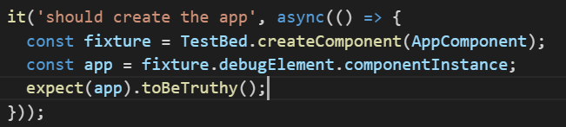
Testing the Component
Call the createComponent method in the TestBed
Check the component’s instance using debugElement.componentInstance
Component’s dependencies should be mocked and a new mock class needs to the created for the dependent class which extends the SpyObject.

Slide 43
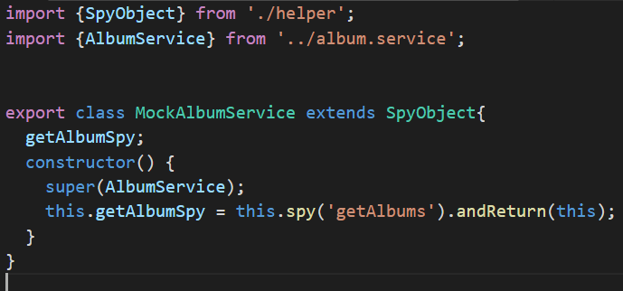
Testing the Component
A spy is a specific type of mock object that gives us two benefits:
we can simulate return values and
count how many times the method was called and with which parameters.
Create a getAlbumSpy

Slide 44
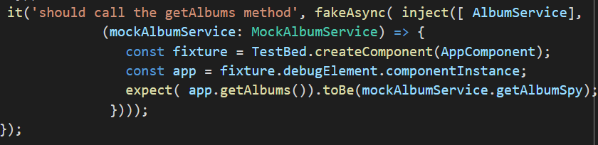
Testing the Component
On testing the methods that calls a service, we test against the spy
Demo

Slide 45
NgModules

Slide 46
Angular Modularity
Modules helps to organize the application.
Extends the app’s capabilities from external libraries.
In-built Angular modules
FormsModule
HttpModule
RouterModule
Modules can be loaded eagerly when the application starts.
They can also be lazy loaded asynchronously by the router.
Notes:
Recollect the NgModules
NgModules consolidate components, directives, and pipes into cohesive blocks of functionality, each focused on a feature area, application business domain, workflow, or common collection of utilities.
So far we have developed only one module when an app loads.

Slide 47
Feature Module
A feature module is a class adorned by the @NgModule decorator and its metadata, just like a root module.
Feature module metadata have the same properties as the metadata for a root module.
The root module and the feature module share the same execution context.
They share the same dependency injector, which means the services in one module are available to all.

Slide 48
Feature Module
Boot the root module to launch the app; Import a feature module to extend the app.
A feature module can expose or hide its implementation from other modules.
A feature module delivers a cohesive set of functionality focused on an application business domain, user workflow, facility (forms, http, routing), or collection of related utilities.
A feature modules help you partition the app into areas of specific interest and purpose.
A feature module collaborates with the root module and with other modules through the services it provides and the components, directives, and pipes that it shares.

Slide 49
Basic Types of Featured Module
Domain
Routed
Service
Widget
Notes:
Routed Module can be eager or lazy loaded.
Service modules are singletons.
Widgets are shared instances. Not singletons, Example Calendar widget. Each instance should take a new state and a behavior.

Slide 50
Basic Types of Feature Module
Domain Module
NgModule is an example for Domain Module. They are bootstrapped during application load.
We can create custom NgModule called feature module. Typically encapsulates a feature of an application.
Eg: University App – Feature Modules can be Department Module, Course Module etc.
Deliver a user experience dedicated to a particular application domain.
Typically imported once by the rootAppModule, without routing.
Notes:
Deliver a user experiencededicated to a particular application domain.
Typically importedonceby the rootAppModule, without routing.

Slide 51
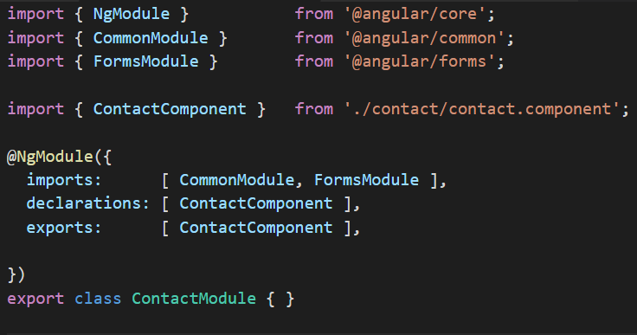
(Domain) Feature Module
Declare the components, that you would to expose in the declarations section and in the exports section
In the main module export include in under imports
https://embed.plnkr.co/lASo4n/

Slide 52
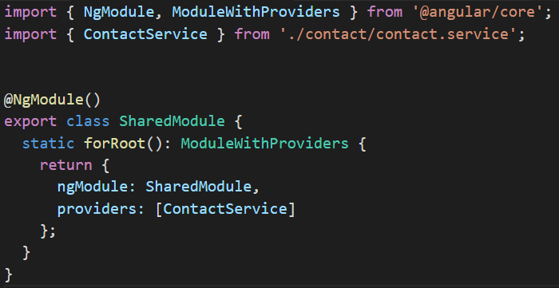
Service-Feature Module
Only one instance of the service is created and it is shared among all other components. Eg( Service class that fetches data from an external service )
https://embed.plnkr.co/rT6vSy/
Notes:
Service feature modules contain singleton services used by anyone across the app.
Generally all providers, no components.
We import them once in App Root Module.

Slide 53
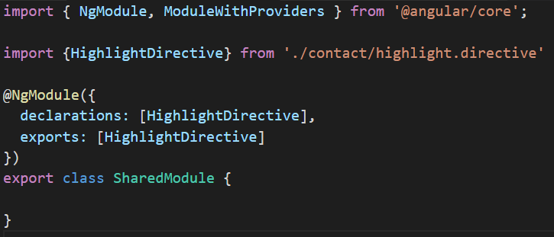
Widget- Featured Module
Directives that should take a new instance like ButtonComponent, DateComponent to use widget-feature module
https://embed.plnkr.co/TbvTyZ/
Notes:
Shared feature modules generally contain components, directives and pipes.
We import these in every module that uses them.

Slide 54
Routed – Lazy Loaded Modules
Eager Loading Modules
Loads at the start-up
Ideal for Modules where the users need it immediately
Loading modules on demand, as needed, just in time lowers the initial payload, improving the app startup experience.
Lazy Loaded modules are ideal for modules not immediately needed in the workflow.
eg – 1. Login modules should always be eager loaded
2. Discount section in an eCommerce site can be loaded lazily.

Slide 55
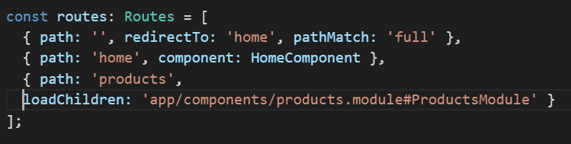
Routed – Lazy Loaded Modules
Lazy Loading
Use loadChildren
Load the module by path # name
Do not import nor reference the module directly

Slide 56
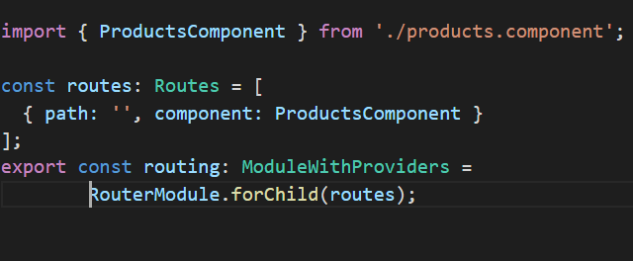
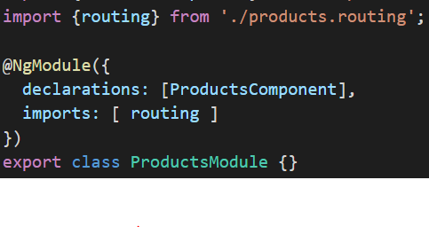
Routed – Lazy Loaded Modules

Slide 57
Providing Services and Their Behaviour
A service provided in a component, is accessible to that component and to its children
When we import a module with providers, we’ll get a new instance of that service upon injection
Be careful putting providers in a module that can be imported more than once
Demo
Demo
Notes:
When we import a module with providers, we’ll get a new instance of that service upon injection

Slide 58
End of Day 03

Slide 59
References
ng-book 2
The Complete Guide to Angular
Written by Nate Murray, Felipe Coury, Ari Lerner, and Carlos Taborda
https://angular.io/
https://angular-university.io/
Angular 2 – First look (John Papa – Pluralsight course)

